Slide 1
User Support
AQS Conference
August 23, 2012
Angie Shatas

Slide 2
We Will Cover
Help Desk
Contacts
Documentation
User Registration
Awards

Slide 3
Helpdesk
EPA Helpdesk
866-411-4372 or epacallcenter@epa.gov
Levels of support
Level 1: password resets for AQSProd; opens a problem ticket
Level 2: AQS-specific issues → Pamela and Donnie
Level 3: server issues → NCC
Level 4: software and data issues → AQS Team
Exchange Network (EN) Helpdesk
888-890-1995 or nodehelpdesk@epacdx.net
Supports:
Node (production) password resets / general Node support
When in doubt, call the EPA Helpdesk.
AQS Conference 2012 – User Support

Slide 4
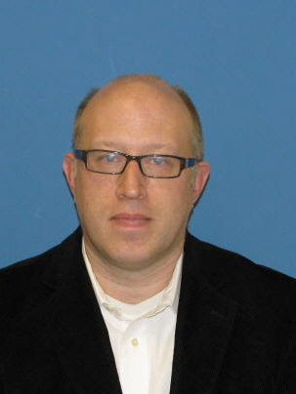
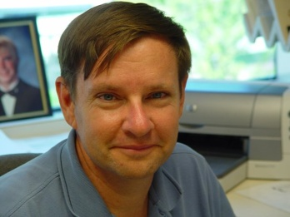
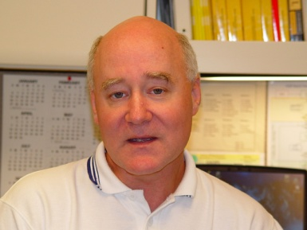
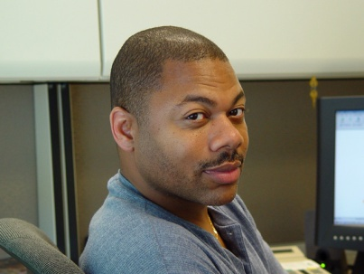
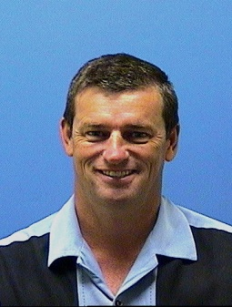
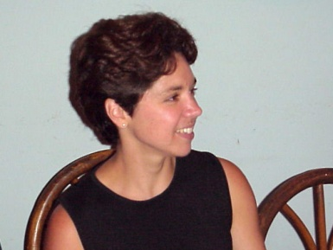
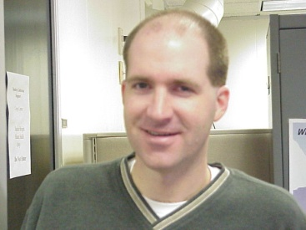
AQS Team
Robert Coats, team lead
Bill Frietsche (QA & audits)
Way Poteat
Chris Chapman
Nick Mangus (Data Mart)
Michael Hamlin (user registration)
Angie Shatas
Have you used AQSTeam@epa.gov to contact us?
If so, what do you think of this process?
AQS Conference 2012 – User Support

Slide 5
AQS Regional Contacts
1: Wendy McDougall
(617) 918-8323
2: Henry Feingersh
(212) 637-3382
3: Pauline DeVose
(215) 814-2186
4: Darren Palmer
(404) 562-9052
5: Jesse McGrath
(312) 886-1532
6: Trisha Curran
(214) 665-8345
7: James Regehr
(913) 551-5063
8: Joe Delwiche
(303) 312-6448
9: Fletcher Clover
(415) 972-3991
10: Jan Noel
(206) 553-1691
AQS Conference 2012 – User Support

Slide 6
Documentation on AQS site
Manuals and Guides:
Design Value Report (SO₂) *
Submit Automation User Guide *
Data Dictionary *
Data Coding Manual
AQS Input Transaction Formats***
Exceptional Event Tutorial
Fundamentals & User Guide **
Data Retrieval Manual **
Codes and Descriptions *
Memos
Software Release Notes *
* New/updated
** These need updates/overhaul
*** Will change in next year

Slide 7

User Registration
New user: Fill out online form.
New user: Scan; send via email (AQSTeam@epa.gov ) or fax.
AQS Team: Create AQS account and contact new user.
AQS Team: Request EN account for non read-only users.
Our goal is to make this an automated, paperless process.
AQS Conference 2012 – User Support

Slide 8
User Awards
“Under the Wire” Award
Last submission to make the Data Completeness deadline
“Neck Crick” Award
Most calls to the EPA Helpdesk
“Jackrabbit” Award
Impressive speed from Basics class to data submittal
“Bug Swatter” Award
Finding and documenting AQS system bugs
“Information Overload” Award
Quantity of raw data recently submitted
“Go the Distance” Award
The longest distance travelled to attend this year’s conference
Notes:
11pm the night before!
_______________________________
AQS problems transferred to Level 2 since last conference – so from Oct 2008.
Lori Howell with 18.
Lisa Wagner had 17
Cecil Williams 15
Lorraine Krecidlo 13
Barb Regynski 12
Camila Tao 12
John Simone 10
___________________________________
Sept 2009 ITEP class in Denver, CO
___________________________________
Exceptional Event implementation!
___________________________________
Raw net data inserts – POSTS - in the last 3 months:
Benedicto (Benny) Villamin – TX DEQ – 3.4M
Jessica Ward – Air Resource Specialists – 1.2M
Robert Kirkwood – Wyoming DEQ – 994k
___________________________________
Anchorage, AK – 3415 miles
Bangor, ME – 2281
Concord, NH – 2098
Lyndhurst, NJ – 1839
Tallahassee, FL – 1578
Montgomery, AL - 1349
Birmingham, AL - 1253

